Slide 1


University of New Haven
Fall 2022
AI Project
Presented By: Professor:
Shiva Ram Reddy Rikka- 00759744 Dr. Shivanjali Khare
Rohit Gottipati- 00751580
Gayathri Chilukuri- 00755590
Academic Year: 2022/2023

Slide 2
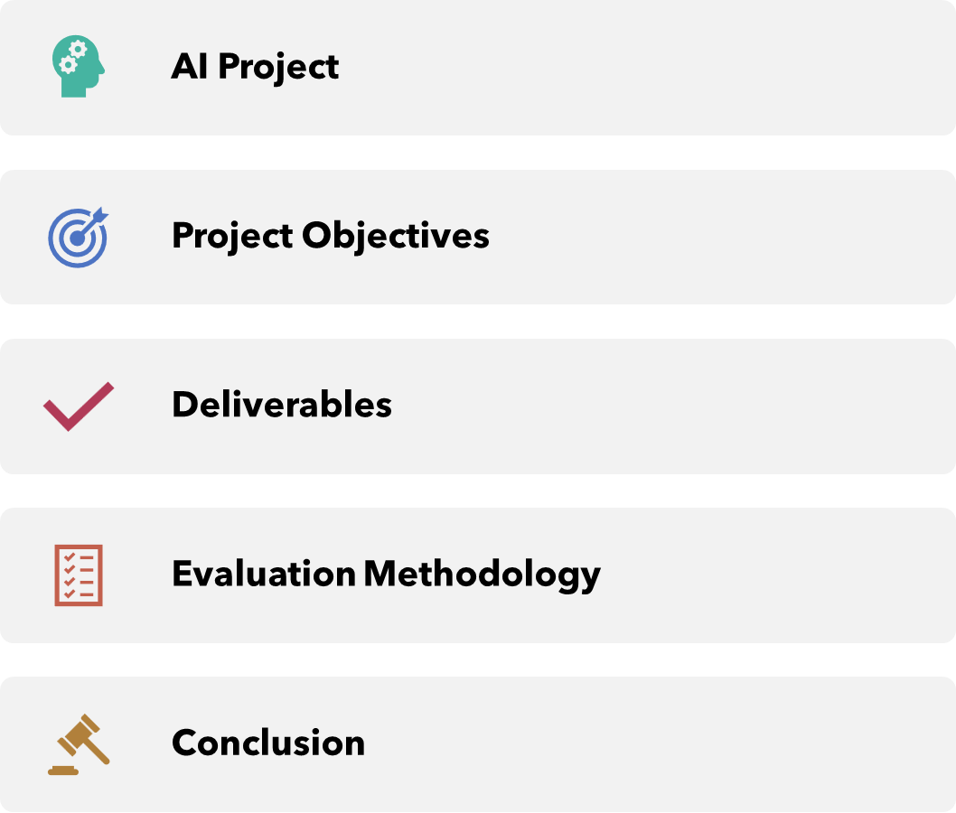
Presentation Plan

Slide 3
AI Project
Brain Tumor Detection
We considered many fields, topics, and subjects to work on for our Ai project; there is a lot of interesting stuff out there.
We decided on the topic of brain tumor detection because many people suffer from this disease and brain tumor detection with AI can assist many doctors with their diagnostics, which is why I chose it.
Brain tumors are regarded as one of the most dangerous diseases in both children and adults. Brain tumors constitute 85 to 90% of all primary Central Nervous System (CNS) tumors. Each year, approximately 11,700 people are diagnosed with brain tumors. The 5-year survival rate for people with a cancerous brain or CNS tumor is around 34% for men and 36% for women.

Slide 4
Project Objectives
Find a dataSet
Find a model
Train the model on the dataset
Execute the model into the dataset
Discuss and show the results

Slide 5
Approach
To achieve automatic brain tumor detection, we chose to use artificial intelligence AI that uses deep learning, which is an artificial neural network, or CNN, to be more precise.
A convolutional neural network (CNN) is a type of artificial neural network that is specifically designed to process pixel data in image recognition and processing.
CNNs are powerful image processing, artificial intelligence (AI) systems that use deep learning to perform both generative and descriptive tasks, frequently using machine vision to recognize images and videos.
After creating the CNN, we will train it on the data set so that the model can distinguish between tumorous and non-tumorous images.
The training set will use the 2 first settings, training, and validation, and we can save the Test set for evaluating our model because it would be inappropriate to test the model on data that he has already seen because he will predict them with 100% accuracy.
Following the previous step, we will test our model in the test set and see what the results are, and then we will be able to determine whether our model is good or bad.

Slide 6


